Slide 1
Technology-based Training system for Novice Players
April 22, 2021
Yihao Wang
Andrew ID: yihaow

Slide 2
Technology-assisted training system for novice players.
Sports Technology using the EMG and IMU.
A badminton training system using the Myo armband.
Observations and conclusion.

Slide 3
Technology-assisted training system for novice players
Multimedia learning systems have been invented and incorporated into sports traing for novice players. Moodle course for table tennis (2012) and Real-time videotaping of badminton training (2018).
Sensor technologies are also incorporated into the training process.
Chen et al. (2013) proposed a yoga self-traing system featuring the Kinect sensor.
Huang et al. (2015) proposed a golf analysis system featuring the Kinect sensors to spot learners’ frequently-made mistakes.
Most sensor technologies are related to movement recognition analysis, but few studies discussed the control of muscle strength.

Slide 4
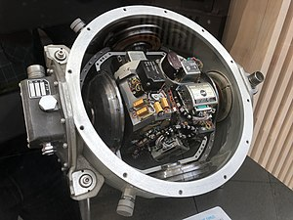
Sports Technology using the IMU and EMG
Inertial Measurement Unit (IMU): It is an electronic device that measures and reports a body‘s specific force, angular rate, and sometimes the orientation of the body.

Slide 5
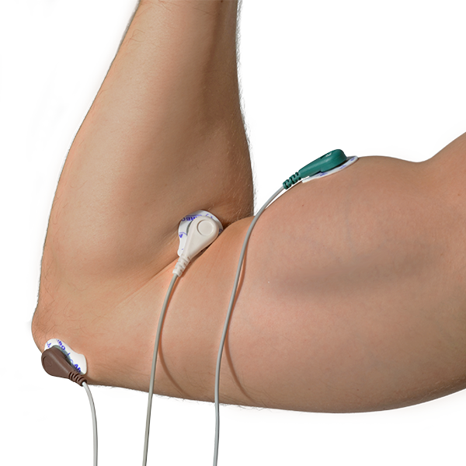
Sports Technology using the IMU and EMG
Electromyography Sensor (EMG): An electromyogram (EMG) measures the electrical activity of muscles at rest and during contraction. This sensor will measure the filtered and rectified electrical activity of a muscle, depending the amount of activity in the selected muscle.

Slide 6
Sports Technology using the IMU and EMG
These motion-sensing technologies have been emplyed in the sports training.
Chang et al. (2014) employed the IMU worn on the user’s back to measure the body rotation kinematic parameters for golf putting.
Kitagama and Ogihara (2016) examined the foot walking trajectories with the IMU. To test the accuracy, the estimated foot trajectories were compared with the conventional motion capture system, and similar results are obtained.
EMG has been regarded as a technology that provides estimates of synaptic action related to behaviors by recording the voltage of electrodes on the muscels, thus providing sufficient feedback.

Slide 7
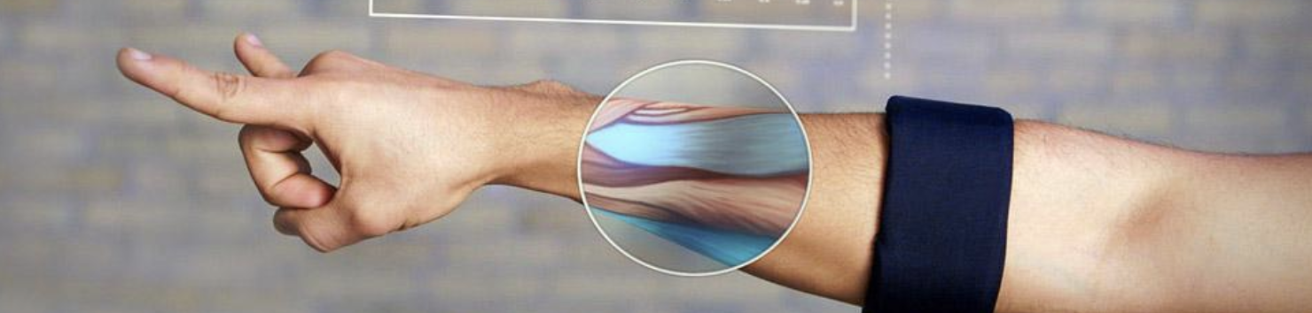
Myo armband
The Myo armband is a wearable movement controlling device, allowing users to control electronic devices such as the laptop and smartphone, remotely without touching.
The device includes eight EMG sensors, and a 9-axis IMU.
The EMG sensors measure different muscle activities in order to detect users’ movements.
the IMU measures the rotation and traces the user’s forearms.
The armband uses Bluetooth to send signals to compatible devices.

Slide 8
A badminton training system using the Myo armband
The aim of this training system using a wearable movement controlling device is to detect the learners’ forearm swinging movements and muscle strength while smashing and backhand driving, and to further provide diagnosis suggestions for enhancing their badminton skills.
It consisted of a perisonal learning profile, an expert badminton database, a student badminton database, and an expert’s model generation with the BPNN, an expert model, and a similarity comparison approach.

Slide 9
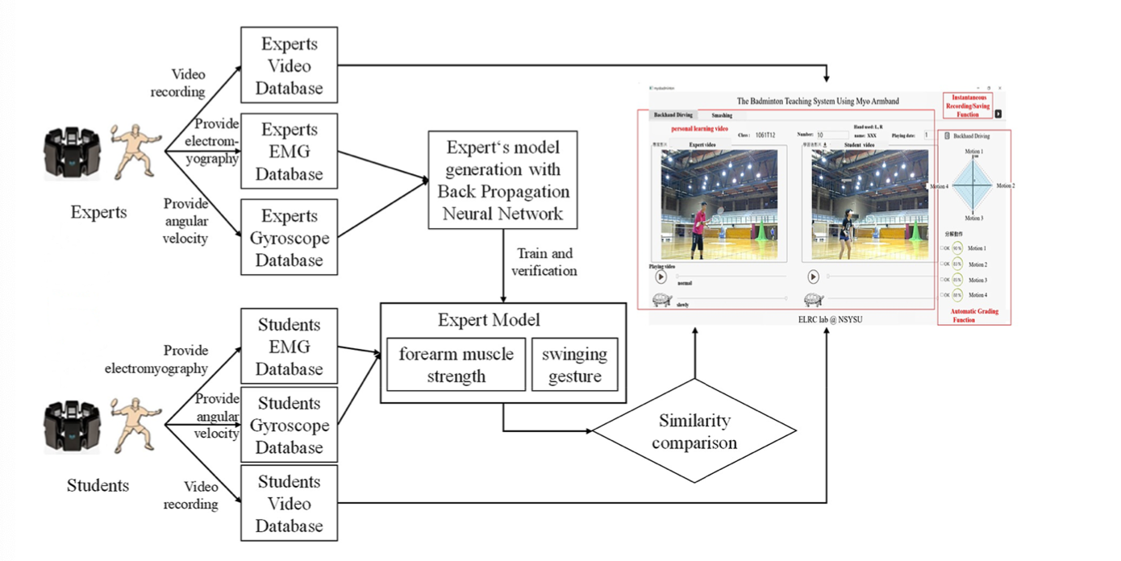
Data Collection
Signal Preprocess
Expert model development
User interface

Slide 10
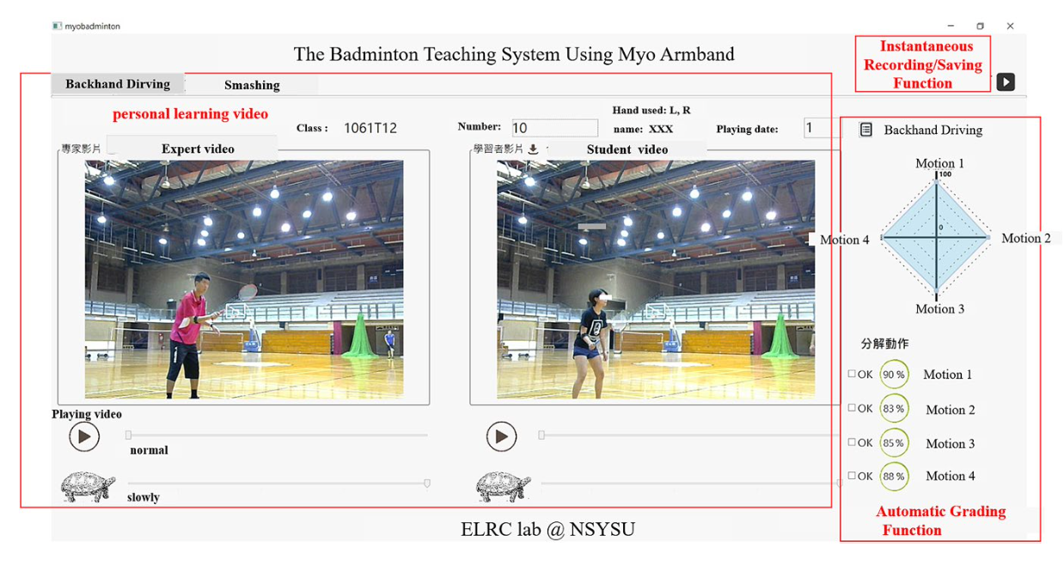
A badminton training system using the Myo armband
The autograding function;
Personal learning videos;
Instantaneouos recording/saving function.

Slide 11
Personal opinions
It is shown that the addition of the training system improves the novice players’ performance especially in two sub-motions (Racket Raising and Holding back the racket waist high and relaxing after strike).
The generality of this system is limited to the badminton sports. However, the idea can be extended to many forms of sports.
It not only assists the novice players’ training but gives more precise guidance to expert players.

Slide 12
Conclusion and observations
The sensor-based training system often measures players’ motions and muscle activity and gives accurate feedback.
The deep learning algorithm helps capture the general feature of expert athletes, which can be applied to many general sports technologies.
The market for sports tech designed for novice players has great potential.

